Slide 2



Slide 3


Slide 4


Slide 5


Slide 6
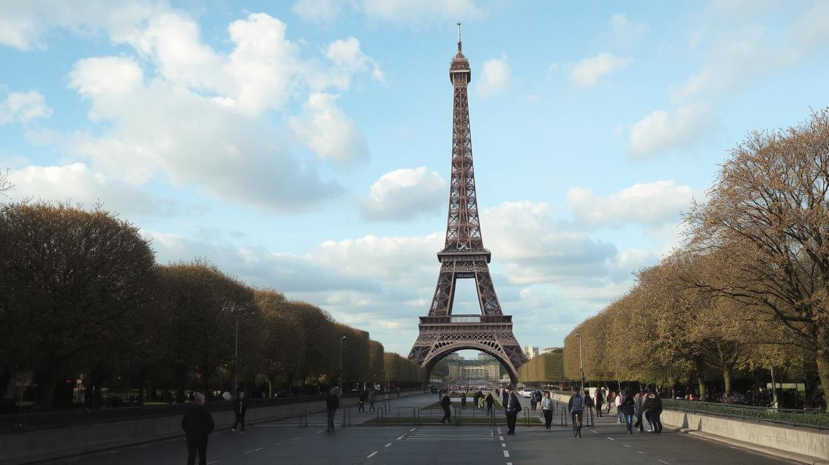
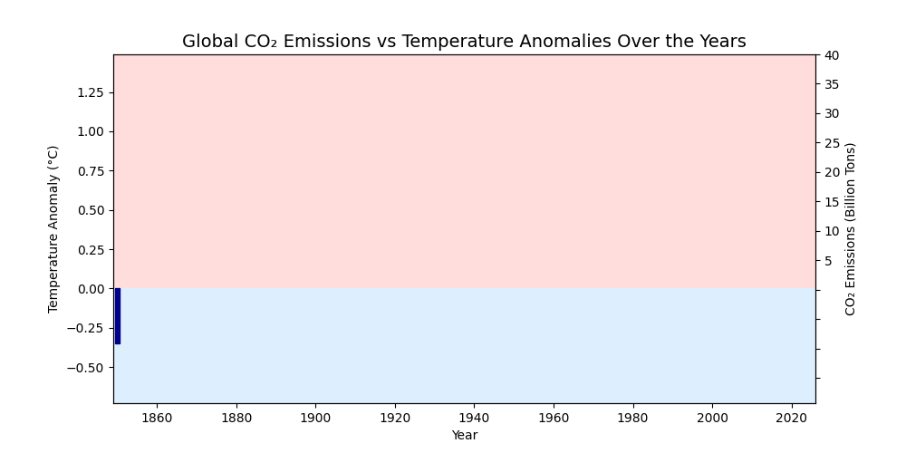

Slide 7

though home to just 0.3% of the global population, ranks among the top per-capita carbon emitters in the world. Our role, therefore, is small in size—but large in impact.
Are we on track to meet our Paris targets by 2030 and net-zero by 2050?
2030:
- 43% reduction in GHG emissions (from 2005 baseline)
- 82% renewable electricity generation
2050:
- Net Zero GHG Emissions
Gross emissions (from human activity) – Removals (e.g., carbon offsets, afforestation, carbon capture) = 0 net emissions
It does not mean zero emissions across the board, but that any emissions produced are counterbalanced by carbon sinks or offsets.
In practice:
Phasing out fossil fuels
Electrifying transport and industry
Expanding renewable energy
Investing in carbon capture, storage, and nature-based solutions (like tree planting or restoring wetlands)

Slide 8
